Slide 1
Chapter 6
Manipulating Arrays
PHP Programming with MySQL
2nd Edition

Slide 2
Objectives
In this chapter, you will:
Manipulate array elements
Declare and initialize associative arrays
Iterate through an array
Find and extract elements and values
Sort, combine, and compare arrays
Understand multidimensional arrays
Use arrays in Web forms
PHP Programming with MySQL, 2nd Edition

Slide 3
Manipulating Elements
if (isset($_POST['submit'])) {
$Subject = stripslashes($_POST['subject']);
$Name = stripslashes($_POST['name']);
$Message = stripslashes($_POST['message']);
// Replace any '~' characters with '-' characters
$Subject = str_replace("~", "-", $Subject);
$Name = str_replace("~", "-", $Name);
$Message = str_replace("~", "-", $Message);
$MessageRecord = "$Subject~$Name~$Message\n";
$MessageFile = fopen("MessageBoard/messages.txt", "ab");
if ($MessageFile === FALSE)
echo "There was an error saving your message!\n";
else {
fwrite($MessageFile, $MessageRecord);
fclose($MessageFile);
echo "Your message has been saved.\n";
}
}
PHP Programming with MySQL, 2nd Edition

Slide 4
Manipulating Elements (continued)
<h1>Post New Message</h1>
<hr />
<form action="PostMessage.php" method="POST">
<strong>Subject:</strong> <input type="text" name="subject" />
<strong>Name:</strong> <input type="text" name="name" /><br />
<textarea name="message" rows="6" cols="80"></textarea><br />
<input type="submit" name="submit" value="Post Message" />
<input type="reset" name="reset" value="Reset Form" />
</form>
<hr />
<a href="MessageBoard.php">View Messages</a>
PHP Programming with MySQL, 2nd Edition

Slide 5
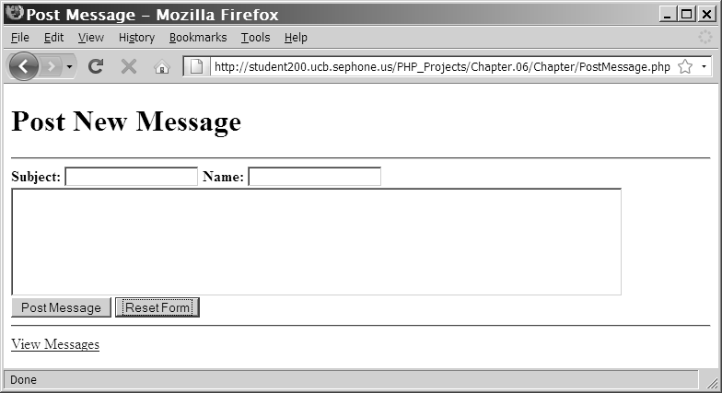
Manipulating Elements (continued)
Figure 6-1 Post New Message page of the Message Board
PHP Programming with MySQL, 2nd Edition

Slide 6
Manipulating Elements (continued)
<h1>Message Board</h1>
<?php
?>
<p>
<a href="PostMessage.php">Post New Message</a>
</p>
if ((!file_exists("MessageBoard/messages.txt")) || (filesize("MessageBoard/messages.txt") == 0))
echo "<p>There are no messages posted.</p>\n";
}
else {
$MessageArray = file("MessageBoard/messages.txt");
echo "<table style=\"background-color:lightgray\"
border=\"1\" width=\"100%\">\n";
$count = count($MessageArray);
PHP Programming with MySQL, 2nd Edition

Slide 7
Manipulating Elements (continued)
for ($i = 0; $i < $count; ++$i) {
$CurrMsg = explode("~", $MessageArray[$i]);
echo " <tr>\n";
echo " <td width=\"5%\"
align=\"center\"><strong>" . ($i + 1) .
"</strong></td>\n";
echo " <td
width=\"95%\"><strong>Subject:</strong> " .
htmlentities($CurrMsg[0]) . "<br />";
echo "<strong>Name:</strong> " .
htmlentities($CurrMsg[1]) . "<br />";
echo "<u><strong>Message</strong></u><br />" .
htmlentities($CurrMsg[2]) . "</td>\n";
echo " </tr>\n";
}
echo "</table>\n";
PHP Programming with MySQL, 2nd Edition

Slide 8
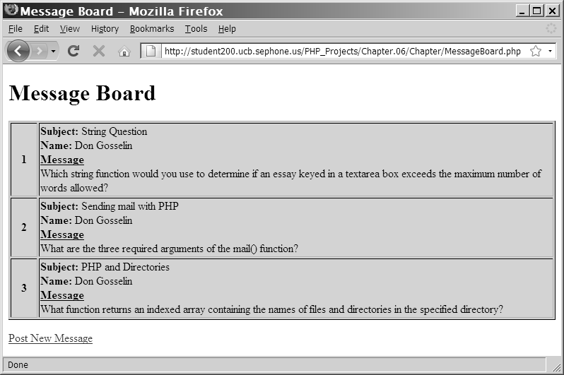
Manipulating Elements (continued)
Figure 6-2 Message Board page of the Message Board
PHP Programming with MySQL, 2nd Edition

Slide 9
Adding and Removing Elements from the Beginning of an Array
The array_shift() function removes the first element from the beginning of an array
  Pass the name of the array whose first element you want to remove
The array_unshift() function adds one or more elements to the beginning of an array
  Pass the name of an array followed by comma-separated values for each element you want to add
PHP Programming with MySQL, 2nd Edition

Slide 10
Adding and Removing Elements from the Beginning of an Array (continued)
$TopSellers = array(
"Chevrolet Impala",
"Chevrolet Malibu",
"Chevrolet Silverado",
"Ford F-Series",
"Toyota Camry",
"Toyota Corolla",
"Nissan Altima",
"Honda Accord",
"Honda Civic",
"Dodge Ram");
array_shift($TopSellers);
array_unshift($TopSellers, "Honda CR-V");
echo "<pre>\n";
print_r($TopSellers);
echo "</pre>\n";
PHP Programming with MySQL, 2nd Edition

Slide 11
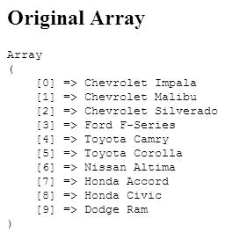
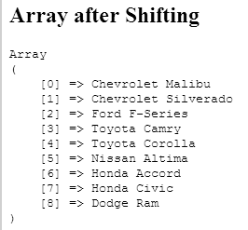
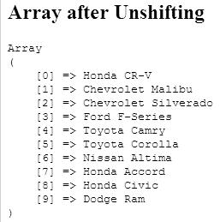
Adding and Removing Elements from the Beginning of an Array (continued)
Figure 6-3 Output of an array modified with the array_shift()
and array_unshift() functions
PHP Programming with MySQL, 2nd Edition

Slide 12
Adding and Removing Elements from the End of an Array
The array_pop() function removes the last element from the end of an array
  Pass the name of the array whose last
  element you want to remove
The array_push() function adds one or more elements to the end of an array
  Pass the name of an array followed by
  comma-separated values for each element
  you want to add
PHP Programming with MySQL, 2nd Edition

Slide 13
Adding and Removing Elements from the End of an Array (continued)
$HospitalDepts = array(
"Anesthesia",
"Molecular Biology",
"Neurology",
"Pediatrics");
array_pop($HospitalDepts); // Removes "Pediatrics"
array_push($HospitalDepts, "Psychiatry", "Pulmonary Diseases");
PHP Programming with MySQL, 2nd Edition

Slide 14
Adding and Removing Elements Within an Array
The array_splice() function adds or removes array elements
The array_splice() function renumbers the indexes in the array
The syntax for the array_splice() function is:
  array_splice(array_name, start, characters_to_delete, values_to_insert);
PHP Programming with MySQL, 2nd Edition

Slide 15
Adding and Removing Elements Within an Array (continued)
To add an element within an array, include a value of 0 as the third argument of the array_splice() function
$HospitalDepts = array(
"Anesthesia", // first element (0)
"Molecular Biology", // second element (1)
"Neurology", // third element (2)
"Pediatrics"); // fourth element (3)
array_splice($HospitalDepts, 3, 0, "Ophthalmology");
PHP Programming with MySQL, 2nd Edition

Slide 16
Adding and Removing Elements Within an Array (continued)
To add more than one element within an array, pass the array() construct as the fourth argument of the array_splice() function
Separate the new element values by commas
$HospitalDepts = array(
"Anesthesia", // first element (0)
"Molecular Biology", // second element (1)
"Neurology", // third element (2)
"Pediatrics"); // fourth element (3)
array_splice($HospitalDepts, 3, 0, array("Opthalmology",
"Otolaryngology"));
PHP Programming with MySQL, 2nd Edition

Slide 17
Adding and Removing Elements Within an Array (continued)
Delete array elements by omitting the fourth argument from the array_splice() function
  $HospitalDepts = array(
  "Anesthesia", // first element (0)
  "Molecular Biology", // second element (1)
  "Neurology", // third element (2)
  "Pediatrics"); // fourth element (3)
  array_splice($HospitalDepts, 1, 2);
PHP Programming with MySQL, 2nd Edition

Slide 18
Adding and Removing Elements Within an Array (continued)
The unset() function removes array elements and other variables
Pass to the unset() function the array name and index number of the element you want to remove
To remove multiple elements, separate each index name and element number with commas
unset($HospitalDepts[1], $HospitalDepts[2]);
PHP Programming with MySQL, 2nd Edition

Slide 19
Removing Duplicate Elements
The array_unique() function removes duplicate elements from an array
Pass to the array_unique() function the name of the array from which you want to remove duplicate elements
The array_values() and array_unique() functions do not operate directly on an array
The array_unique() function does renumber the indexes after removing duplicate values in an array
PHP Programming with MySQL, 2nd Edition

Slide 20
Removing Duplicate Elements (continued)
$TopSellers = array(
"Ford F-Series", "Chevrolet Silverado", "Toyota Camry",
"Honda Accord", "Toyota Corolla", "Ford F-Series", "Honda Civic",
"Honda CR-V", "Honda Accord", "Nissan Altima", "Toyota Camry",
"Chevrolet Impala", "Dodge Ram", "Honda CR-V");
echo "<p>The 2008 top selling vehicles are:</p><p>";
$TopSellers = array_unique($TopSellers);
$TopSellers = array_values($TopSellers);
for ($i=0; $i<count($ TopSellers); ++$i) {
echo "{$TopSellers[$i]}<br />";
}
echo "</p>";
PHP Programming with MySQL, 2nd Edition

Slide 21
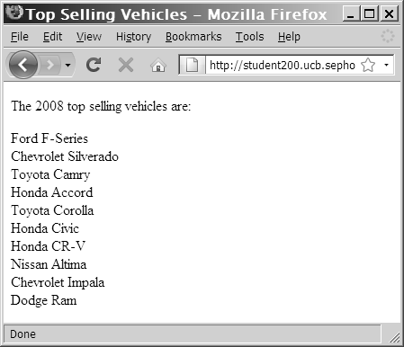
Removing Duplicate Elements (continued)
Figure 6-4 Output of an array after removing duplicate values
with the array_unique() function
PHP Programming with MySQL, 2nd Edition

Slide 22
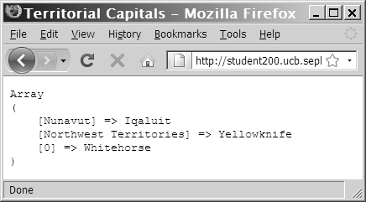
Declaring and Initializing Associative Arrays
With associative arrays, you specify an element’s key by using the array operator (=>)
  The syntax for declaring and initializing an associative array is:
$array_name = array(key=>value, ...);
Figure 6-5 Output of array with associative and indexed elements
PHP Programming with MySQL, 2nd Edition

Slide 23
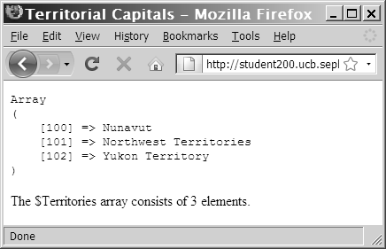
Declaring and Initializing Associative Arrays (continued)
$Territories[100] = "Nunavut";
$Territories[] = "Northwest Territories";
$Territories[] = "Yukon Territory";
echo "<pre>\n";
print_r($Territories);
echo "</pre>\n";
echo '<p>The $Territories array consists of ',
count($Territories), " elements.</p>\n";
Figure 6-6 Output of an array with a starting index of 100
PHP Programming with MySQL, 2nd Edition

Slide 24
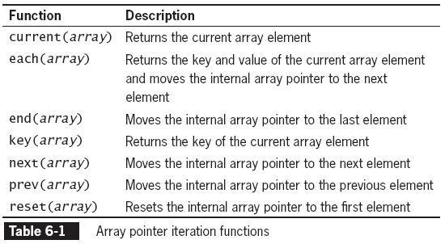
Iterating Through an Array
The internal array pointer refers to the currently selected element in an array
PHP Programming with MySQL, 2nd Edition

Slide 25
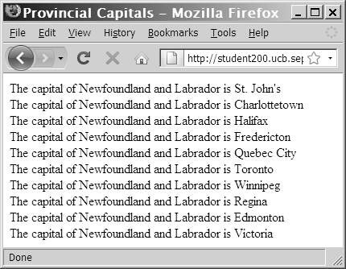
Iterating Through an Array (continued)
Figure 6-8 Output of an array without advancing the internal
array pointer
PHP Programming with MySQL, 2nd Edition

Slide 26
Finding and Extracting Elements and Values
One of the most basic methods for finding a value in an array is to use a looping statement to iterate through the array until you find the value
Rather than write custom code to find a value, use the in_array() and array_search() functions to determine whether a value exists in an array
PHP Programming with MySQL, 2nd Edition

Slide 27
Determining if a Value Exists
The in_array() function returns a Boolean value of true if a given value exists in an array
The array_search() function determines whether a given value exists in an array and:
  Returns the index or key of the first matching element if the value exists, or
  Returns FALSE if the value does not exist
if (in_array("Neurology", $HospitalDepts))
echo "<p>The hospital has a Neurology department.</p>";
PHP Programming with MySQL, 2nd Edition

Slide 28
Determining if a Key Exists
The array_key_exists() function determines whether a given index or key exists
You pass two arguments to the array_key_exists() function:
  The first argument represents the key to
  search for
  The second argument represents the name
  of the array in which to search
PHP Programming with MySQL, 2nd Edition

Slide 29
Determining if a Key Exists (continued)
$ScreenNames["Dancer"] = "Daryl";
$ScreenNames["Fat Man"] = "Dennis";
$ScreenNames["Assassin"] = "Jennifer";
if (array_key_exists("Fat Man", $ScreenNames))
echo "<p>{$ScreenNames['Fat Man']} is already
'Fat Man'.</p>\n";
else {
$ScreenNames["Fat Man"] = "Don";
echo "<p>{$ScreenNames['Fat Man']} is now
'Fat Man'.</p>";
}
PHP Programming with MySQL, 2nd Edition

Slide 30
Returning a Portion of an Array
The array_slice() function returns a portion of an array and assigns it to another array
The syntax for the array_slice() function is:
array_slice(array_name, start, characters_to_return);
PHP Programming with MySQL, 2nd Edition

Slide 31
Returning a Portion of an Array (continued)
// This array is ordered by sales, high to low.
$TopSellers = array("Ford F-Series", "Chevrolet Silverado", "Toyota Camry", "Honda Accord", "Toyota Corolla", "Honda Civic", "Nissan Altima", "Chevrolet Impala", "Dodge Ram", "Honda CR-V");
$FiveTopSellers = array_slice($TopSellers, 0, 5);
echo "<p>The five best-selling vehicles for 2008 are:</p>\n";
for ($i=0; $i<count($FiveTopSellers); ++$i) {
echo "{$FiveTopSellers[$i]}<br />\n";
}
PHP Programming with MySQL, 2nd Edition

Slide 32
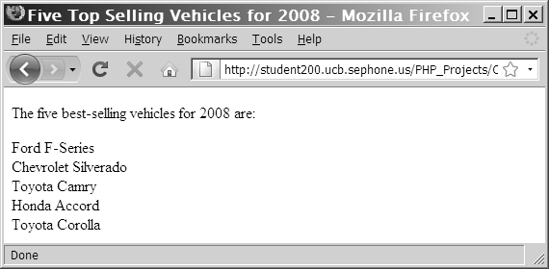
Returning a Portion of an Array (continued)
Figure 6-11 Output of an array returned with the
array_slice() function
PHP Programming with MySQL, 2nd Edition

Slide 33
Sorting Arrays
The most commonly used array sorting
functions are:
  sort() and rsort() for indexed arrays
  ksort() and krsort() for associative arrays
PHP Programming with MySQL, 2nd Edition

Slide 34
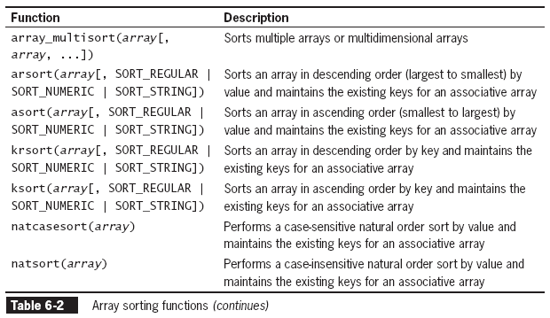
Sorting Arrays (continued)
PHP Programming with MySQL, 2nd Edition

Slide 35
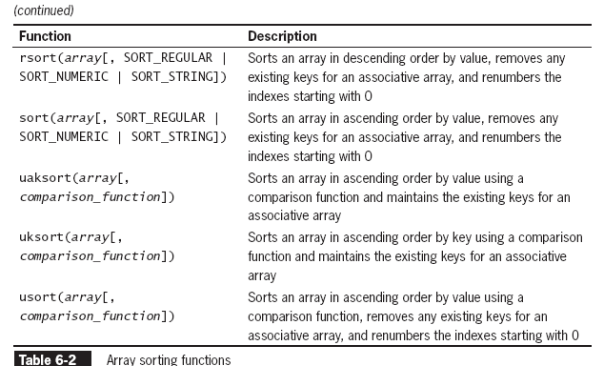
Sorting Arrays (continued)
PHP Programming with MySQL, 2nd Edition

Slide 36
Sorting Arrays (continued)
If the sort() and rsort() functions are used on an associative array, the keys are replaced with indexes
PHP Programming with MySQL, 2nd Edition

Slide 37
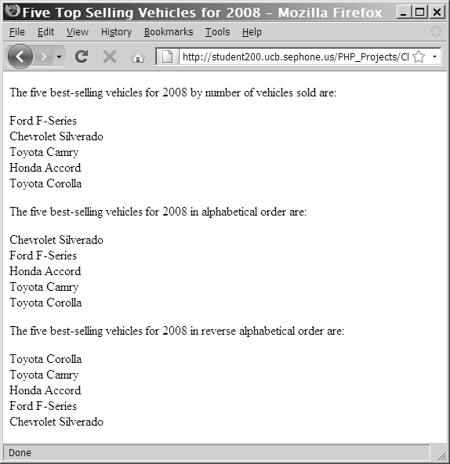
Sorting Arrays (continued)
Figure 6-12 Output of an array after applying the sort() and rsort() functions
PHP Programming with MySQL, 2nd Edition

Slide 38
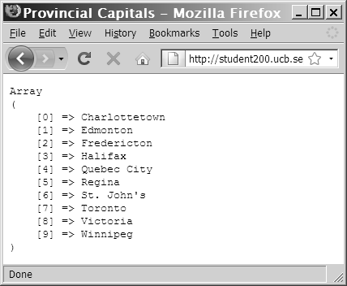
Sorting Arrays (continued)
Figure 6-13 Output of an associative array after sorting with the sort() function
PHP Programming with MySQL, 2nd Edition

Slide 39
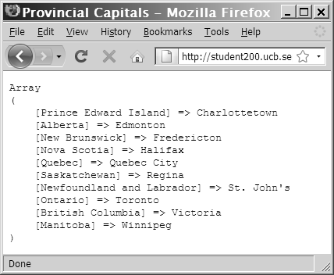
Sorting Arrays (continued)
Figure 6-14 Output of an associative array after sorting
with the asort() function
PHP Programming with MySQL, 2nd Edition

Slide 40
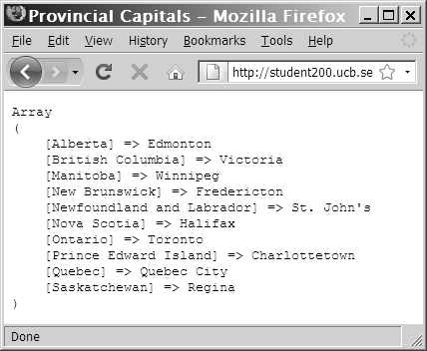
Sorting Arrays (continued)
Figure 6-15 Output of an associative array
after sorting with the ksort() function
PHP Programming with MySQL, 2nd Edition

Slide 41
Combining Arrays
To append one array to another, use the addition (+) or the compound assignment operator (+=)
To merge two or more arrays use the array_merge() function
The syntax for the array_merge() function is:
new_array = array_merge($array1, $array2, $array3, ...);
PHP Programming with MySQL, 2nd Edition

Slide 42
Combining Arrays (continued)
$Provinces = array("Newfoundland and Labrador", "Prince Edward Island", "Nova Scotia", "New Brunswick", "Quebec", "Ontario", "Manitoba", "Saskatchewan", "Alberta", "British Columbia");
$Territories = array("Nunavut", "Northwest Territories", "Yukon Territory");
$Canada = $Provinces + $Territories;
echo "<pre>\n";
print_r($Canada);
echo "</pre>\n";
PHP Programming with MySQL, 2nd Edition

Slide 43
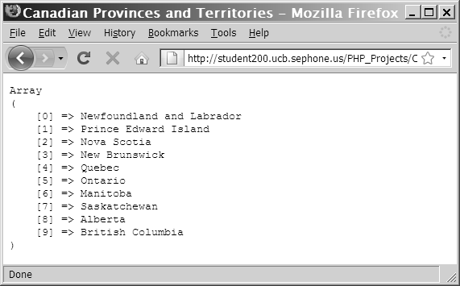
Combining Arrays (continued)
Figure 6-12 Output of two indexed arrays combined with the addition operator
PHP Programming with MySQL, 2nd Edition

Slide 44
Comparing Arrays
The array_diff() function returns an array of elements that exist in one array but not in any other arrays to which it is compared
The syntax for the array_diff() function is:
new_array = array_diff($array1, $array2, $array3, ...);
The array_intersect() function returns an array of elements that exist in all of the arrays that are compared
PHP Programming with MySQL, 2nd Edition

Slide 45
Comparing Arrays (continued)
The syntax for the array_intersect() function is:
new_array = array_intersect($array1,
$array2, $array3, ...);
PHP Programming with MySQL, 2nd Edition

Slide 46
Comparing Arrays (continued)
$ProvincialCapitals = array("Newfoundland and Labrador"=>"St. John's", "Prince Edward Island"=>"Charlottetown", "Nova Scotia"=>"Halifax", "New Brunswick"=>"Fredericton", "Quebec"=>"Quebec City", "Ontario"=>"Toronto", "Manitoba"=>"Winnipeg", "Saskatchewan"=>"Regina", "Alberta"=>"Edmonton", "British Columbia"=>"Victoria");
$TerritorialCapitals = array("Nunavut"=>"Iqaluit", "Northwest Territories"=>"Yellowknife", "Yukon Territory"=>"Whitehorse");
$CanadianCapitals = $ProvincialCapitals + $TerritorialCapitals;
echo "<pre>\n";
print_r($CanadianCapitals);
echo "</pre>\n";
PHP Programming with MySQL, 2nd Edition

Slide 47
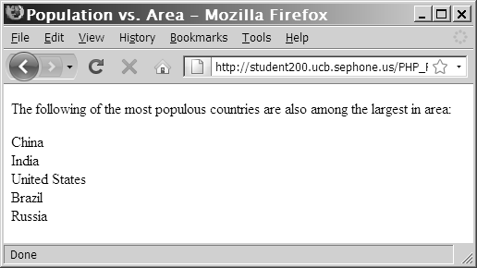
Comparing Arrays (continued)
Figure 6-20 Output of an array created with the
array_intersect() function
PHP Programming with MySQL, 2nd Edition

Slide 48
Comparing Arrays (continued)
$Provinces = array("Newfoundland and Labrador", "Prince Edward Island", "Nova Scotia", "New Brunswick", "Quebec", "Ontario", "Manitoba", "Saskatchewan", "Alberta", "British Columbia");
$Territories = array("Nunavut", "Northwest Territories", "Yukon Territory");
$Canada = array_merge($Provinces, $Territories);
PHP Programming with MySQL, 2nd Edition

Slide 49
Creating Two-Dimensional
Indexed Arrays
A multidimensional array consists of multiple indexes or keys
A two-dimensional array has two sets of indexes or keys
PHP Programming with MySQL, 2nd Edition

Slide 50
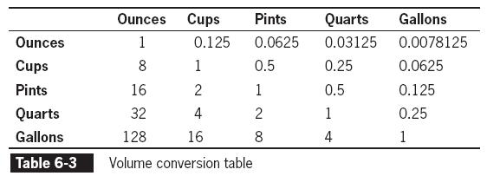
Creating Two-Dimensional
Indexed Arrays (continued)
$Gallons = array(
128, // ounces
16, // cups
8, // pints
4 // quarts
);
PHP Programming with MySQL, 2nd Edition

Slide 51
Creating Two-Dimensional
Indexed Arrays (continued)
$Ounces = array(1, 0.125, 0.0625, 0.03125, 0.0078125);
$Cups = array(8, 1, 0.5, 0.25, 0.0625);
$Pints = array(16, 2, 1, 0.5, 0.125);
$Quarts = array(32, 4, 2, 1, 0.25);
$Gallons = array(128, 16, 8, 4, 1);
PHP Programming with MySQL, 2nd Edition

Slide 52
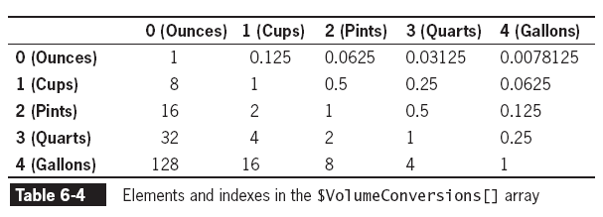
Creating Two-Dimensional
Indexed Arrays (continued)
$VolumeConversions = array($Ounces, $Cups, $Pints, $Quarts, $Gallons);
PHP Programming with MySQL, 2nd Edition

Slide 53
Creating Two-Dimensional
Associative Arrays
$Ounces = array("ounces" => 1, "cups" => 0.125, "pints" => 0.0625, "quarts" => 0.03125, "gallons" => 0.0078125);
$Cups = array("ounces" => 8, "cups" => 1, "pints" =>0.5, "quarts" => 0.25, "gallons" => 0.0625);
$Pints = array("ounces" => 16, "cups" => 2, "pints" =>1, "quarts" => 0.5, "gallons" => 0.125);
$Quarts = array("ounces" => 32, "cups" => 4, "pints" =>2, "quarts" => 1, "gallons" => 0.25);
$Gallons = array("ounces" => 128, "cups" => 16, "pints" =>8, "quarts" => 4, "gallons" => 1);
PHP Programming with MySQL, 2nd Edition

Slide 54
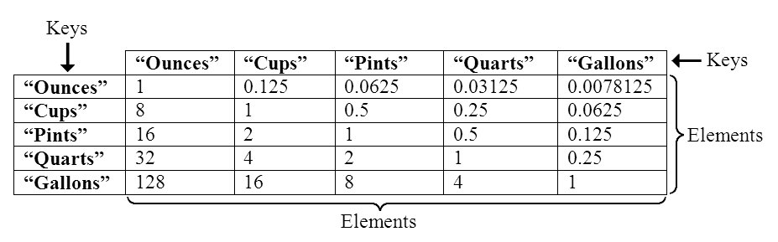
Creating Two-Dimensional Associative Arrays (continued)
Figure 6-21 Elements and keys in the
$VolumeConversions[ ] array
PHP Programming with MySQL, 2nd Edition

Slide 55
Creating Multidimensional Arrays with a Single Statement
$VolumeConversions = array(
array(1, 0.125, 0.0625, 0.03125, 0.0078125), // Ounces
array(8, 1, 0.5, 0.25, 0.0625), // Cups
array(16, 2, 1, 0.5, 0.125), // Pints
array(32, 4, 2, 1, 0.25), // Quarts
array(128, 16, 8, 4, 1) // Gallons
);
PHP Programming with MySQL, 2nd Edition

Slide 56
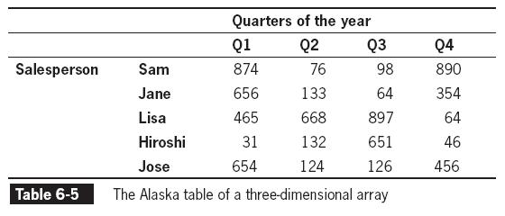
Working with Additional Dimensions
PHP Programming with MySQL, 2nd Edition

Slide 57
Using Arrays in Web Forms
Store form data in an array by appending an opening and closing ([]) to the value of the name attribute
Data from any element with the same value for the name attribute will be appended to an array with that name
PHP Programming with MySQL, 2nd Edition

Slide 58
Using Arrays in Web Forms
(continued)
<form method='post' action='ProcessForm.php'>
<p>Enter the first answer:
<input type='text' name='answers[]' /></p>
<p>Enter the second answer:
<input type='text' name='answers[]' /></p>
<p>Enter the third answer:
<input type='text' name='answers[]' /></p>
<input type='submit' name='submit' value='submit' />
</form>
PHP Programming with MySQL, 2nd Edition

Slide 59
Using Arrays in Web Forms
(continued)
if (is_array($_POST['answers')) {
$Index = 0;
foreach ($_POST['answers'] as $Answer) {
++$Index;
echo "The answer for question $Index is '$Answer'<br />\n";
}
}
PHP Programming with MySQL, 2nd Edition

Slide 60
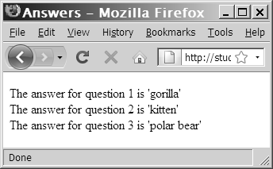
Using Arrays in Web Forms
(continued)
Figure 6-22 Output of an array posted from a Web form
PHP Programming with MySQL, 2nd Edition

Slide 61
Using Multidimensional Array Notation
Multidimensional array notation can also be used to process posted form information
if (is_array($_POST['answers')) {
$count = count($_POST['answers']);
for ($i=0; $i<$count; ++$i) {
echo "The answer for question " . ($i+1) . " is '{$_POST['answers'][$i]}'<br />\n";
}
}
PHP Programming with MySQL, 2nd Edition

Slide 62
Creating an Associative Forms Array
<form method='post' action='ProcessForm.php'>
<p>Enter the first answer:
<input type='text' name='answers[Question 1]' /></p>
<p>Enter the second answer:
<input type='text' name='answers[Question 2]' /></p>
<p>Enter the third answer:
<input type='text' name='answers[Question 3]' /></p>
<input type='submit' name='submit' value='submit' />
</form>
PHP Programming with MySQL, 2nd Edition

Slide 63
Summary
The array_shift() function removes the first element from the beginning of an array
The array_unshift() function adds one or more elements to the beginning of an array
The array_pop() function removes the last element from the end of an array
The array_push() function adds one or more elements to the end of an array
The array_splice() function adds or removes array elements
PHP Programming with MySQL, 2nd Edition

Slide 64
Summary (continued)
The unset() function removes array elements and other variables
The array_values() function renumbers an indexed array’s elements
The array_unique() function removes duplicate elements from an array
The in_array() function returns a Boolean value of TRUE if a given value exists in an array
The array_search() function determines whether a given value exists in an array
PHP Programming with MySQL, 2nd Edition

Slide 65
Summary (continued)
The array_key_exists() function determines whether a given index or key exists
The array_slice() function returns a portion of an array and assigns it to another array
The array_merge() function merges two or more arrays
The array_diff() function returns an array of elements that exist in one array but not in any other arrays to which it is compared
PHP Programming with MySQL, 2nd Edition

Slide 66
Summary (continued)
The array_intersect() function returns an array of elements that exist in all of the arrays that are compared
A multidimensional array consists of multiple sets of indexes or keys
A two-dimensional array has two sets of indexes or keys
When array notation is used in the name of a Web form input, the value gets stored in a nested array within the $_POST or $_GET array
PHP Programming with MySQL, 2nd Edition

Slide 67
Summary (continued)
When using associative array notation in a Web form, you omit the quotation marks around the key name
PHP Programming with MySQL, 2nd Edition

